Slide 1
Maths
Unit 4 – Addition and Subtraction
WALT:
6Ni.01 – Estimate, add and subtract integers.

Slide 2



WALT: Estimate, add and subtract integers.
I can add and subtract negative numbers.
I can complete word problems about negative numbers.
I can explain my answer to a word problem.

Slide 3
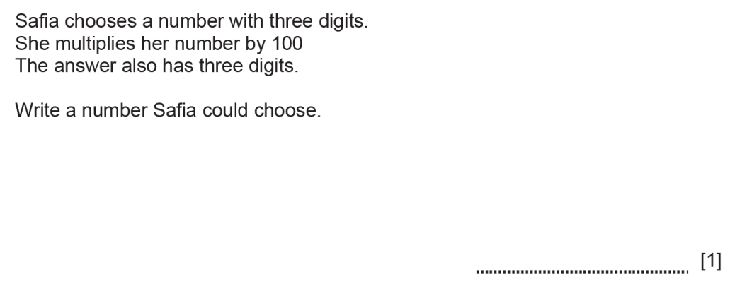
Retrieval Practice
WALT: Estimate, add and subtract integers.

Slide 4
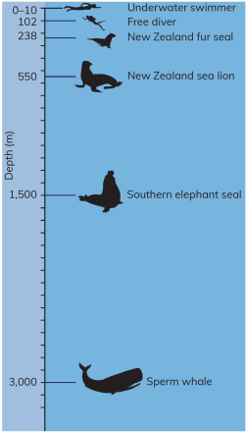
Starter -
WALT: Estimate, add and subtract integers.
How much deeper:
Does a sperm whale dive than a southern elephant seal?
Does a New Zealand sea lion dive than a free diver?
Does a sperm whale dive than a New Zealand fur seal?
1,500m
448m
2,762m

Slide 5
Last lesson we learned how important it was to estimate and check our answers when adding and subtracting integers.
WALT: Estimate, add and subtract integers.
Please remember:
Estimate
Calculate
Check

Slide 6

Let’s remind ourselves how to add and subtract negative numbers.
WALT: Estimate, add and subtract integers.
-10 + 4 =

Slide 7
Let’s remind ourselves how to add and subtract negative numbers.
WALT: Estimate, add and subtract integers.
-2 - 3 =
-5

Slide 8
We also need to be able to answer worded questions.
WALT: Estimate, add and subtract integers.
The temperature in Helsinki is -23°C. The temperature in London is 3°C. What is the difference between the two temperatures?
26°C

Slide 9
Check your understanding
WALT: Estimate, add and subtract integers.
a) -4 + 7 = b)6 – 10 =
-4
3
c) The highest mountain Ms. Colette has ever climbed is 1,300 m. Mount Everest is 8,850m. How further would Ms. Colette need to climb to reach the height of Everest?
7,550 metres

Slide 10
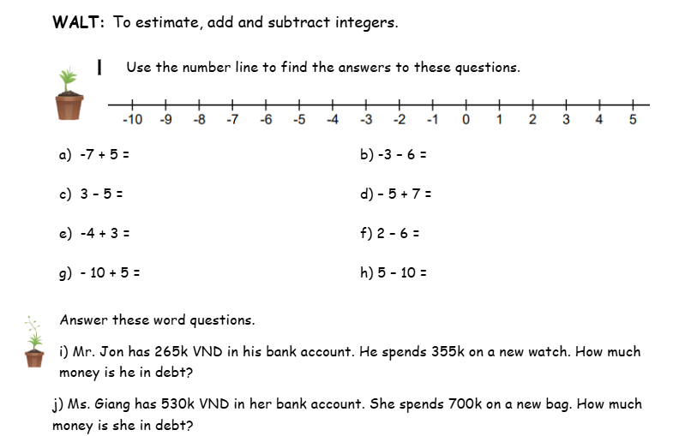
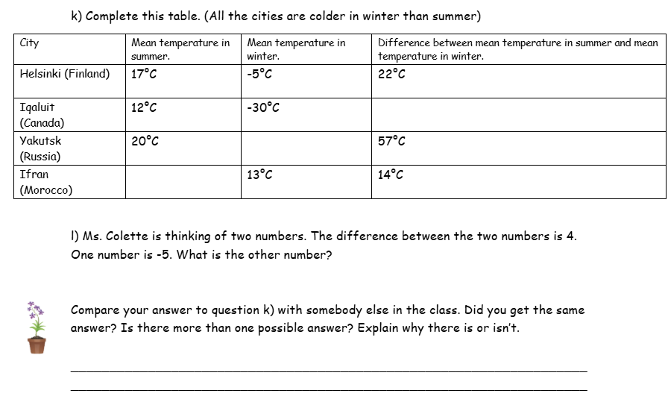
WALT: Estimate, add and subtract integers.

Slide 11
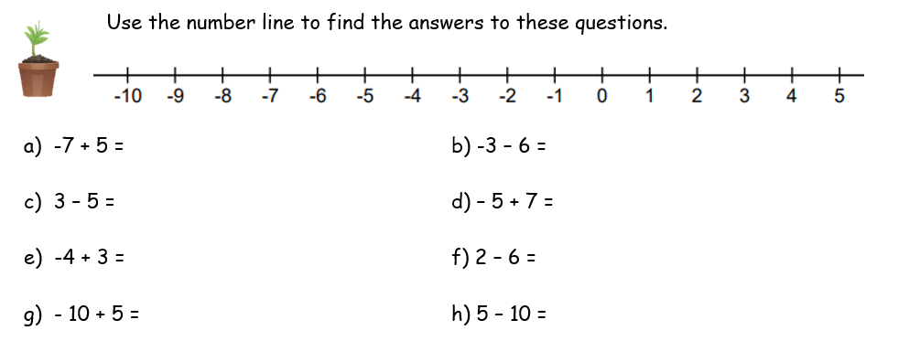
WALT: Estimate, add and subtract integers.
-2
-9
-2
-2
-1
-4
-5
-5

Slide 12
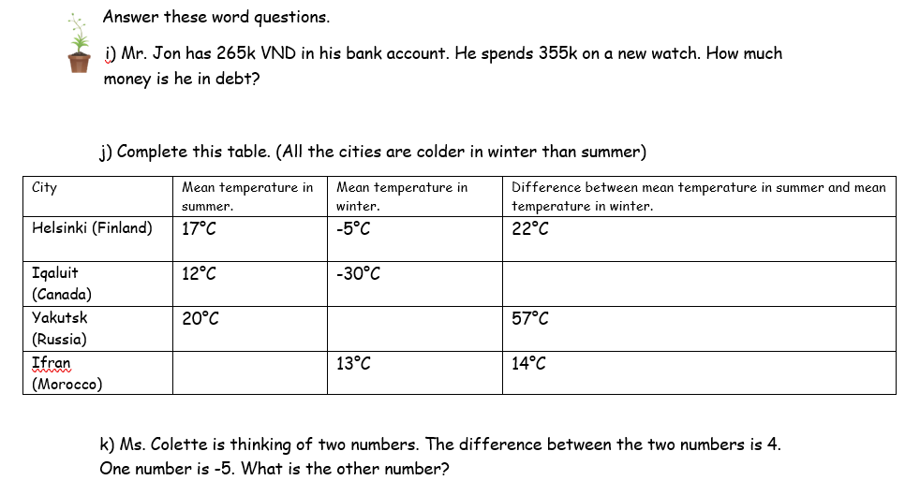
WALT: Estimate, add and subtract integers.
90k VND
42°C
-37°C
27°C
-9 or -1

Slide 13
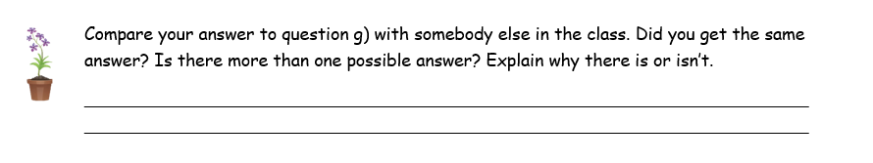
WALT: Estimate, add and subtract integers.

Slide 14
WALT: Estimate, add and subtract integers.
I can add and subtract negative numbers.
I can complete word problems about negative numbers.
I can explain my answer to a word problem.

Slide 15
Plenary – Is Ms. Colette correct? Why / Why not?
WALT: Estimate, add and subtract integers.
Ms. Colette says, “The difference between -5 and -9 is -4.”

